Slide 1
WNBA/NBA Rim Heights
B.G. Lemmon
Tara Rosen
July 2, 2019

Slide 2
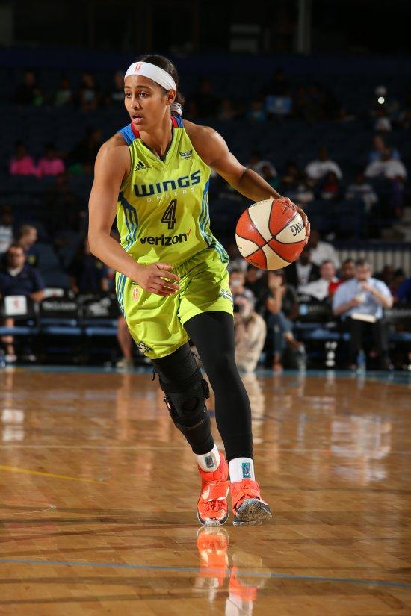
Background of Project
We are HUGE sports fans
BG’s fiancée, however, is not…
Took an interest to Women’s sports one day when I left ESPN on TV
As a result, we became fans of the Dallas Wings WNBA Team
WNBA Game seems a lot different than NBA, when it really shouldn’t be. Why is that?!!
Skyler Diggins-Smith, Dallas Wings Guard

Slide 3
NBA vs. WNBA ‘Excitement’ Metrics
Total Points Per Game
3 Point Attempts
Fast Break Attempts
Clutch Time
Dunks

Slide 4
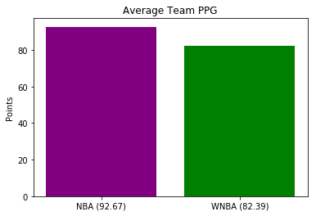
Total Points Per Game (Adjusted)
NBA: 92.67 ppg
WNBA: 82.39 ppg
Two-Sample t-test:
p-value = 2.1477 e-07
Results Statistically Significant

Slide 5
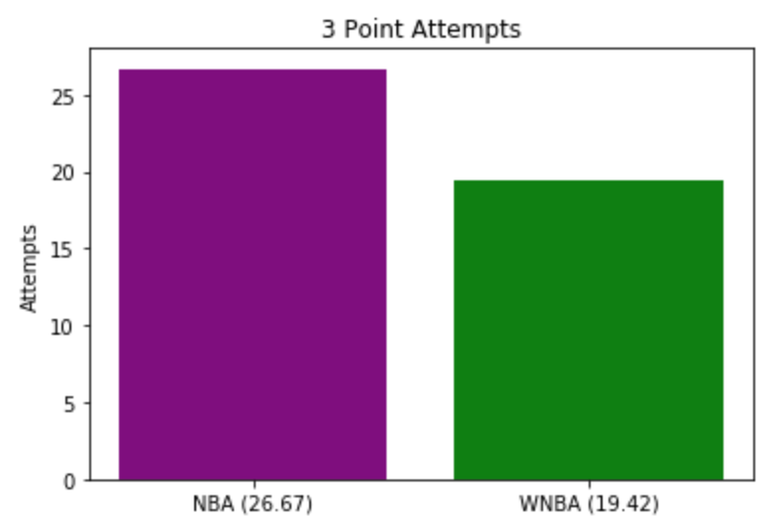
3-Point Attempts (Adjusted)
NBA: 26.67 3PA
WNBA: 19.42 3PA
Two-Sample t-test:
p-value = 1.9014 e-05
Results Statistically Significant

Slide 6
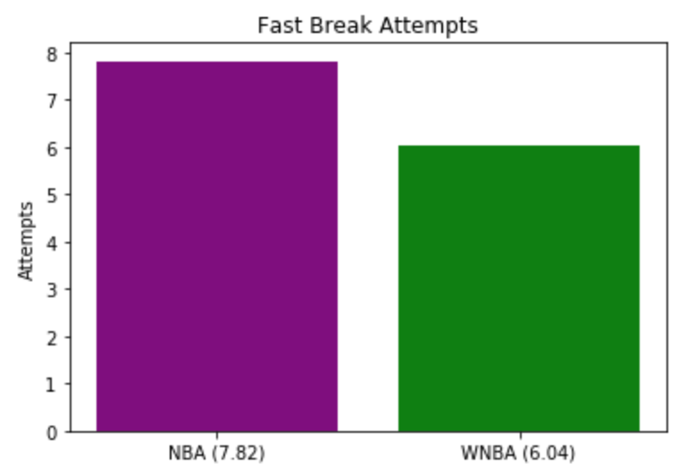
Fast Break Attempts (Adjusted)
NBA: 7.82 fba
WNBA: 6.04 fba
Two-Sample t-test:
p-value = 1.8564 e-04
Results Statistically Significant

Slide 7
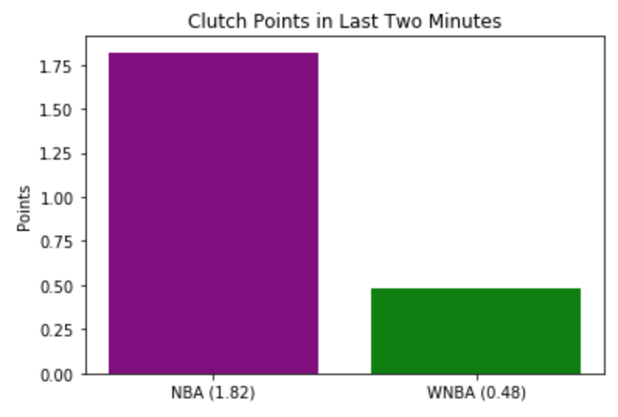
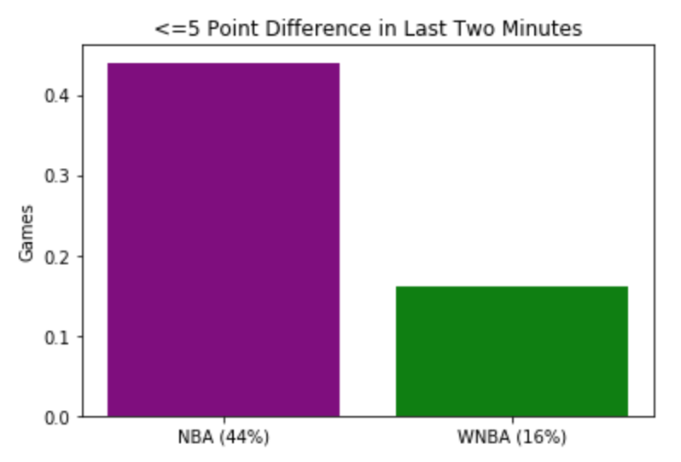
Clutch Time
(Point differential <= 5 pts with 2 min remaining)
NBA: 44% games
WNBA: 16% games
Two-Sample t-test:
p-value = 1.5833 e-29
Results Statistically Significant

Slide 8
Dunks
NBA: over 11,000 dunks in 2018-19 Season alone...
...and in the WNBA since its inception in 1997...
11 Total Dunks!

Slide 9
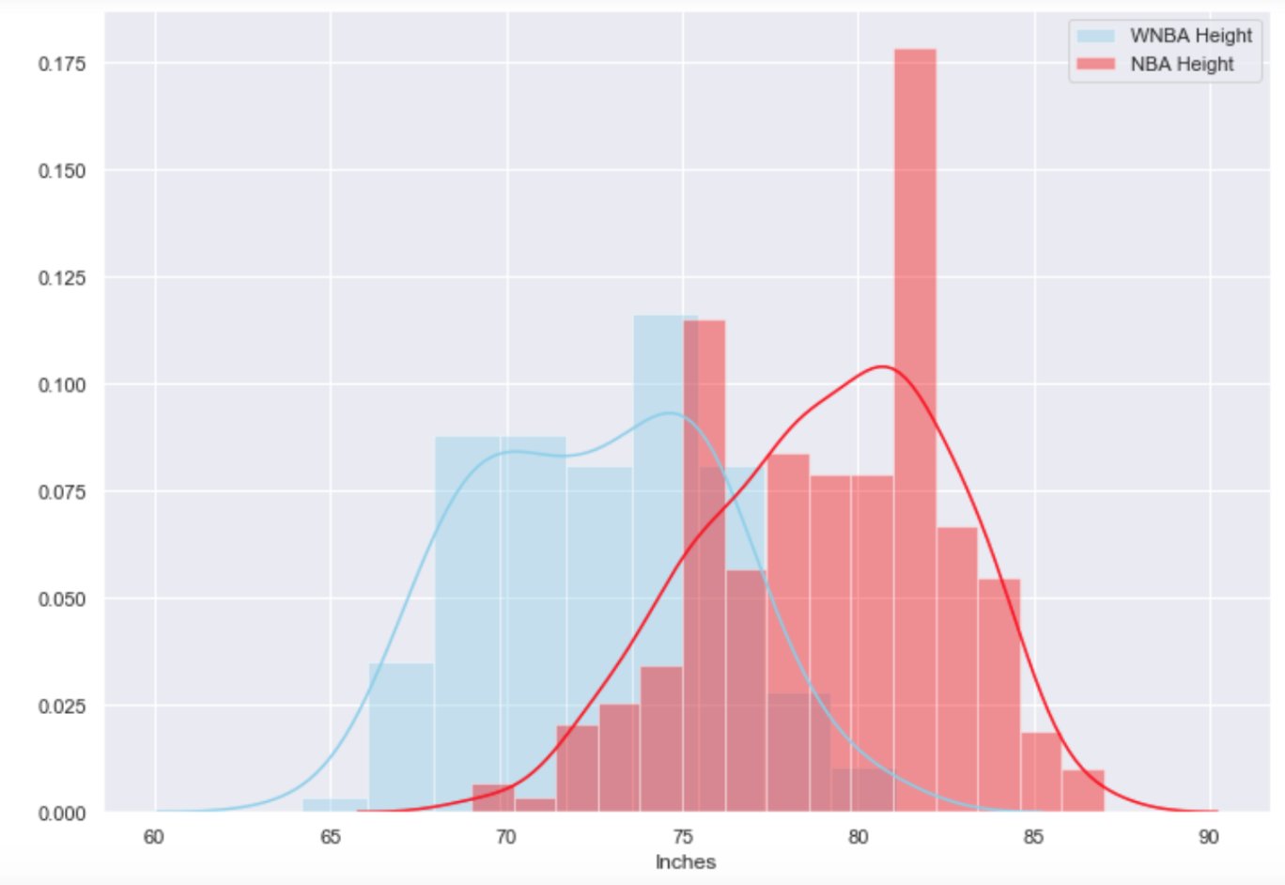
NBA vs. WNBA Height
But they play on the same rim height??

Slide 10
Height Analysis
NBA Player Mean Height: 79.10 inches (about 6 ft. 7 in.)
WNBA Player Mean Height: 72.57 inches (about 6 ft.)
NCAAM Player Mean Vertical: 28.1 inches
NCAAW Player Mean Vertical: 19.0 inches
Avg. Human Standing Reach: 1.33x Normal Height
NBA Player Reaching Jump: (1.33 * 79.10) + 28.1 ≈ 133.3 inches
WNBA Player Reaching Jump: (1.33 * 72.57) + 19.0 ≈ 115.5 inches

Slide 11
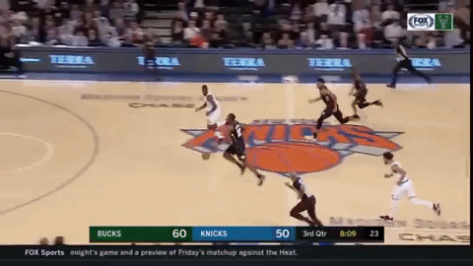
Dunking 101
To dunk a basketball, you need to have a “reaching jump” 6 inches above the rim height
At 120 inches (10 feet), an average NBA player meets that requirement easily (133.3 inches) while an average WNBA player falls well short of that (115.5 inches)
How do we fix this problem??

Slide 12
Lower the Rim in the WNBA!!

Slide 13
NBA Rim Equivalent
(WNBA Player “Reaching Jump”)
(NBA Player “Reaching Jump”)
115.5 Inches
133.3 Inches
120.0 Inches
X
(WNBA / NBA Rim Height)
(NBA Rim Height Equivalent)
(133.3 in. * 120.0 in.) / 115.5 in. ≈ 138.5 inches!!
...or 11.5 Feet!!

Slide 14
...therefore, we believe...

Slide 15
Proposed WNBA Rim
(NBA Player “Reaching Jump”)
(WNBA Player “Reaching Jump”)
133.3 Inches
115.5 Inches
120.0 Inches
X
(WNBA / NBA Rim Height)
(WNBA Proposed Rim Height)
(115.5 in. * 120.0 in.) / 133.3 in. ≈ 104 inches!!
...or 8 Feet 8 Inches!!

Slide 16
Why Would This Help???

Slide 17
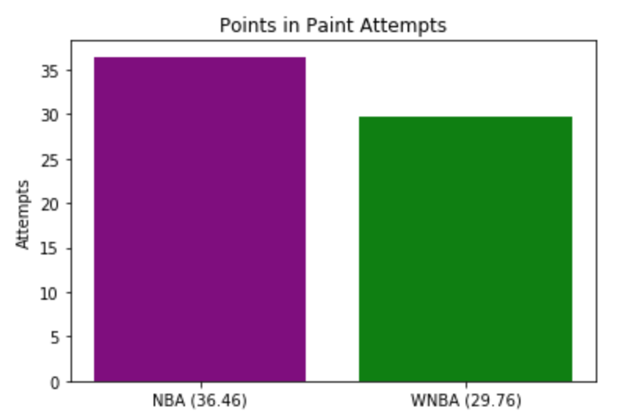
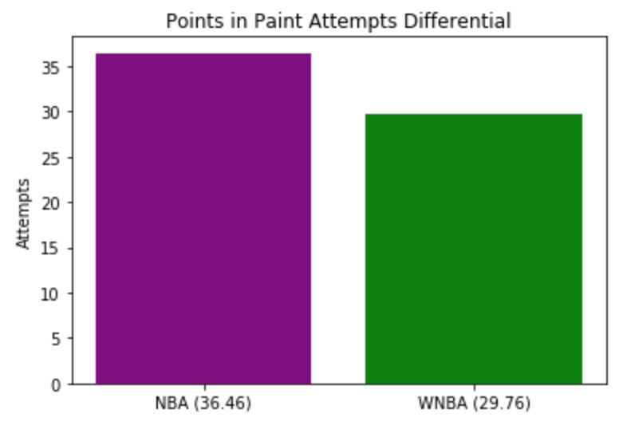
Points in Paint FG Attempts (Adjusted)
NBA: 36.46 FGA (Paint)
WNBA: 29.76 FGA (Paint)
Two-Sample t-test:
p-value = 2.39118 e-06
Results Statistically Significant
Notes:
WNBA - Average from less than 5 feet in 2018 Season was 60.2%, next highest was from 5-9 feet at 42.9%
NBA - Average from less than 5 feet was 65.8%, next highest was 10-16 at 41.1%

Slide 18
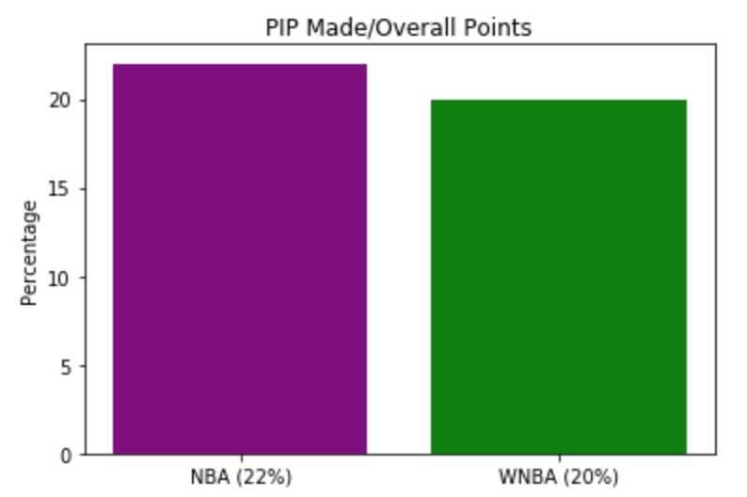
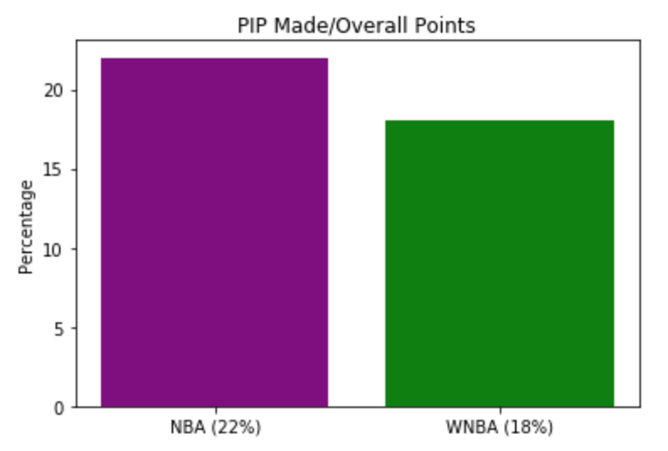
Total Points in Paint/Total Points
NBA: 22%*
WNBA: 20%
Two-Sample t-test:
p-value = 4.62958 e-03
Results Statistically Significant
* In 2013-2014, this number was 41% before
3-PT Revolution took over the NBA...

Slide 19
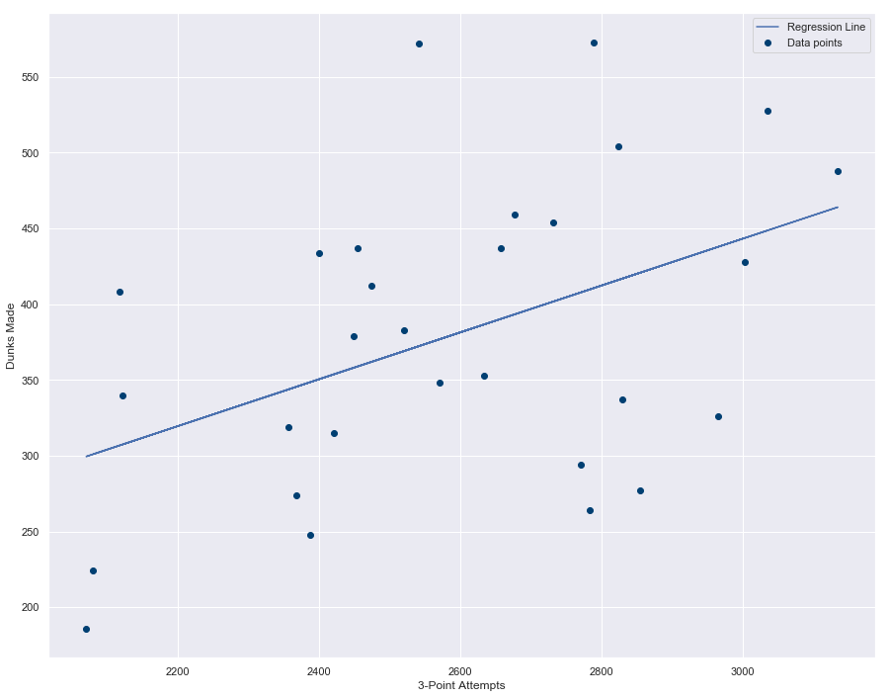
Correlation of 3PT Attempts and Dunks (NBA)
Lower Rim = More Dunks
More Dunks = More 3PA!!
More Fun / Excitement!!!!
Correlation of 0.45
P-value of 0.02

Slide 20
To The Naysayers
There is precedent for women playing sports on different playing fields:
LPGA - shorter tee boxes
Volleyball - nets are 7 inches lower than the men
Tennis - Play best of 2 out of 3 sets as opposed to best of 3 out of 5
There is also precedent for sports making changes to rules to change playing style:
NCAAM extending 3-PT Line
NBA adding Defensive 3 second violation
NFL adding Roughing the Passer penalties and Horse Collar Tackle Penalties

Slide 21
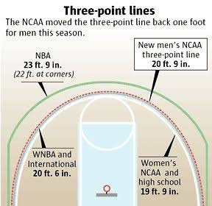
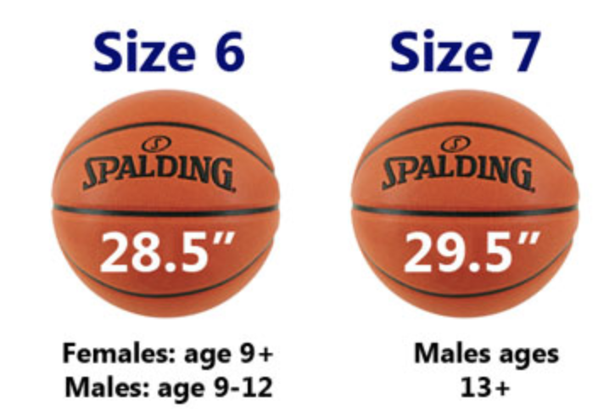
To The Naysayers
The women already have a closer 3 point line:
The women already play with a smaller ball:

Slide 22
Conclusions
WNBA Rim Height should be lowered to 8 ft. and 8 in.
This would allow plays such as alley-oops and dunks to become incorporated into the game
...which would highlight other plays such as 3-PT shooting, pick and rolls, etc.
Game would be more exciting and display true athleticism of the WNBA Players rather than crippling them with this significant disadvantage

Slide 23

Thanks!
B.G. Lemmon
Tara Rosen
July 2, 2019
DS042219

